Slide 1


yugabyteDB query plan management (qpm)
sales.person@yugabyte.com
dan.farrell@yugabyte.com

Slide 2
why:
the dark arts, secret sauce, voodoo magic of relational databases
regularly move queries from 5 minutes to sub-second
big (and distributed) systems .. issues get hidden
Objectives for today; query plan mgmt
what:
where this fits in performance tuning
a full query optimizer primer; no pre-requisites, [ any database ]
the 4 stage backend
rules based optimizers, cost based
examples
finally, query plan management
demonstration:
alerting on regressions
© 2026 All Rights Reserved

Slide 3
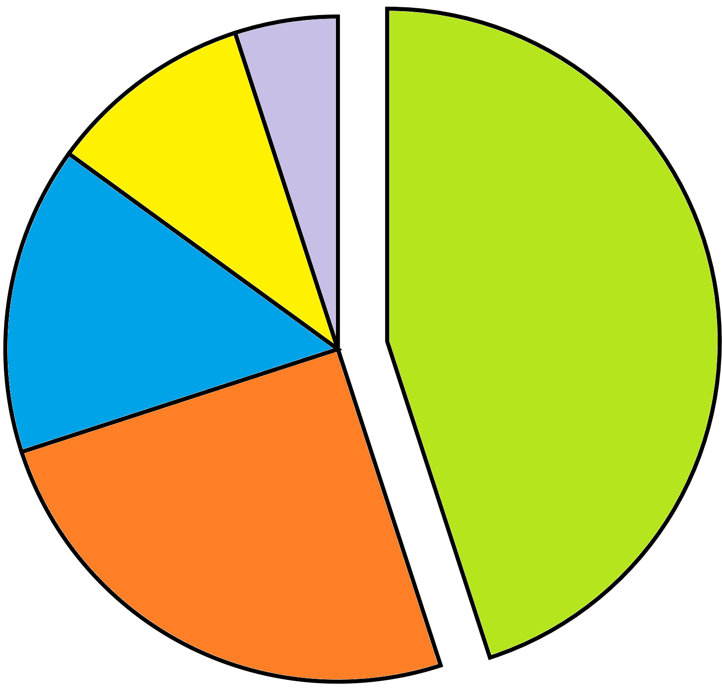
where this fits in performance tuning
5% HW, OS, infrastructure tuning
bad predicates, missing WHERE-clause sargability, unnecessary subqueries, wrong join strategy. consistently the single biggest lever, a single bad query can dominate total load regardless of how well everything else is tuned
10% DB server instance tuning
normalization level, missing/redundant indexes, partitioning strategy, data types sized appropriately. you can't fix a full table scan with a better-written query if the index simply doesn't exist
45% SQL statement tuning
15% application data-access patterns
45% + 25% = 70%
25% schema, index design
N+1 query patterns from ORMs, missing connection pooling, chatty round-trips, lack of batching/caching, wrong isolation level for the workload
memory allocation, buffer/cache sizing, background process config, checkpoint/vacuum tuning, cost-based optimizer settings
storage IOPs, network latency, CPU/RAM sizing, OS-level tuning

Slide 4

sargability – Search ARGument availABLE
Examples;
.. WHERE YEAR(order_date) = 2026
.. WHERE order_date >= '2026-01-01' AND order_date < '2027-01-01'
.. WHERE price * 1.08 > 100
.. WHERE price > 100 / 1.08
.. WHERE cust_id = '1234' -- implicit type cast conversion
.. WHERE cust_id = 1234
All potential forms of "index negation", an abstraction (topic) we will revisit later
index negation: an existing, perfectably good index can not, or should not be used

Slide 5
which of these-
reads ?
writes ?
SELECT
INSERT
UPDATE
DELETE
reads: processing, identifying data that is already present

Slide 6



the 4 stage backend
SQL, declarative
CREATE TABLE (etc) ..
or,
SELECT .. WHERE
UPDATE .. WHERE
DELETE .. WHERE
PREPARE
or the driver, automatic preparation
Parsing phase ?
can be 85% catalog work
authenticate, authorize
read
SQL
write
1.) parser
2.) query optimizer
3.) query processor
client app
data
4.) [ run time libraries ]

Slide 7

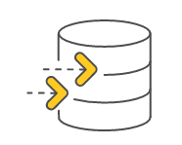
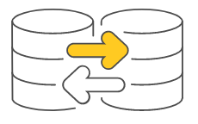
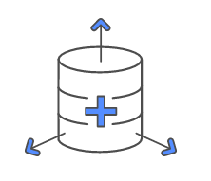
seeing parsing overhead
FOR i = 1 TO 10M
INSERT …
120 seconds ?
or
1.) parser
client app
PREPARE …
FOR i = 1 TO 10M
EXECUTE …
4.) [ run time libraries ]
8 seconds ?

Slide 8
query optimizer; what constitutes a query (execution) plan
file (table) access method
join method
table order
predicate pushdown, filter placement
aggregation strategy
sort elimination
subquery transformation
materialization versus pipe lining
parallel execution planning
partition pruning
constants folding, expression simplification
view/CTE inlining

Slide 9
file access methods, (traditionally, all databases)
.. WHERE prod_name = 'Mustard'
index lookup ( O ( log n )) much better at scale
sequential scan ( O ( n ))
…
rowid
prod_num
prod_name
rowid
prod_num
prod_name
H-I x0j3
x0cc
407
Milk
x0cc
407
Milk
J-K x0l1
xocd
411
Bread
xocd
411
Bread
L-Me x0c5
x0e1
402
Cheese
x0e1
402
Cheese
A-G
x0f2
452
Meat
x0f2
452
Meat
A-M
H-M
Mf-Mu xon3
x0f6
422
Eggs
x0f6
422
Eggs
N-Z
N-T
Mv-Mz x0e4
x0m1
419
Batteries
x0m1
419
Batteries
U-Z
…
xon3
444
Mustard
xon3
444
Mustard
…
…
…
…
…
…
…
index types:
b-tree+, (implied above) the oldest sql index type, volatile data, equality and range
hash, second oldest, most performant, equality yes, range no
lsm, log structured merge-tree, modern choice (index ordered tables)
gin
bitmap
(other)

Slide 10
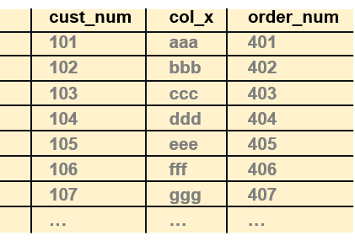
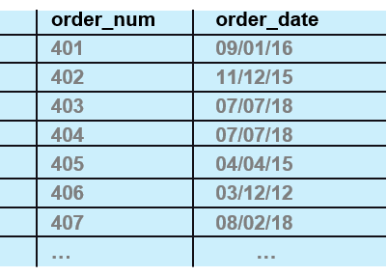
join method, table order
join methods:
nested loop join (implied here), the oldest
batch nested loop join (optimized for distributed)
hash join
merge join (sort-merge)

Slide 11

rules based optimizer (rbo), cost based optimizer (cbo)
rules based optimizer
original
based on sound principles
a decision tree
5 rules applied in order to determine query plan
outer joins
joins
filters
table size
table cardinality
cost based optimizer
rbo, plus statistics about the data
same principles (they were not broken)

Slide 12
example 01
1
2
3
4
5
6
7
8
9
10
difficulty
only because it has 3 simple things going on
© 2026 All Rights Reserved

Slide 13
example 01:
5 rules applied in order to determine query plan
outer joins
joins
filters
table size
table cardinality
select *
from t1, t2
where
t1.col1 = t2.col1
and
t1.col1 = 5
and
t2.col2 > 5
order by
t2.col2;
query plan
file (table) access method
join method
table order

Slide 14
but first, 7'th grade algebra; the associative property
select *
from t1, t2
where
t1.col1 = t2.col1
and
t1.col1 = 5
and
t2.col2 > 5
order by
t2.col2;
select *
from t1, t2
where
t1.col1 = t2.col1
and
t1.col1 = 5
and
t2.col1 = 5
and
t2.col2 > 5
order by
t2.col2;
applies to addition, multiplication
not subtraction, division
in this context,
A = B, B = C, thus A = C

Slide 15
also first; the "psuedo order by clause" (a query rewrite)
select *
from t1, t2
where
t1.col1 = t2.col1
and
t1.col1 = 5
and
t2.col1 = 5
and
t2.col2 > 5
order by
t2.col1, t2.col2;
why-
one index
pre-sorted data ( "pipelined sort" )

Slide 16
example 01
solution
© 2026 All Rights Reserved

Slide 17
example 01: determing the query plan, applying the rules
select *
from t1, t2
where
t1.col1 = t2.col1
and
t1.col1 = 5
and
t2.col1 = 5
and
t2.col2 > 5
order by
t2.col1, t2.col2;
outer joins
joins
filters
table size
table cardinality
not present
all tables joined (common, 2nd table+)
98% of the time (determines first table)
(not needed)
(not needed)
filter → join → sort FJS
worse table first
make the nested, repetitive action the most efficient
huh ?
the nested table will likely have the best access method
as efficiently as possible, reduce the number of tuples to be processed

Slide 18
example 01: which query predicate (filter)
5 rules applied in order to determine query plan
outer joins
joins
filters
table size
table cardinality
select *
from t1, t2
where
t1.col1 = t2.col1
and
t1.col1 = 5
and
t2.col2 > 5
order by
t2.col2;
(estimating) filter selectivity
equality on unique index, 1 tuple
equality on duplicate index, heuristic, 100 tuples
range on duplicate index, heuristic/complicated, historically it was 1/3 of tuples

Slide 19
example 01: how, why
…
where
t1.col1 = t2.col1
and
t1.col1 = 5
and
t2.col1 = 5
and
t2.col2 > 5
order by
t2.col1, t2.col2;
best access method: indexed read into t2 (col1, col2)
(table order set, t2 → t1)
best access method: indexed read into t1 (col1)
SQL, table relationships (cardinality)
1:1, M:M, 1:M, 98% are 1:M
t1 was our parent, t2 a child (count the join pairs)
join method
determined (supported by) available indexes
small tables can alter this

Slide 20
example 01: the actual code behind this
-- Explicit HASH primary key (yugabyteDB's preferred PK syntax) rather
-- than the bare "col1 INT PRIMARY KEY" shorthand, which defaults to a
-- range-sharded (ASC) index here. col1 is a monotonically increasing
-- sequence (1..100,000) -- range sharding on that would hotspot writes
-- onto one tablet range at a time; hashing spreads rows evenly across
-- tablets by hash(col1) instead.
CREATE TABLE t1 (
col1 INT,
col2 INT,
col3 TEXT,
PRIMARY KEY (col1 HASH)
);
-- 100,000 rows, col1 = 1..100,000 (unique -- the join key)
INSERT INTO t1 (col1, col2, col3)
SELECT g, 1 + (g % 1000), repeat('x', 50)
FROM generate_series(1, 100000) AS g;

Slide 21
example 01: the actual code behind this
-- Composite primary key (col1, col2): col1 carries the equality
-- join/filter (t1.col1 = t2.col1 = 5), col2 the range filter (> 5) --
-- putting both in the PK lets the planner satisfy the WHERE clause with
-- a single index scan instead of a 1,000,000-row seq scan, AND return
-- rows already in col2 order within that col1 value, which can let it
-- skip the separate Sort step for "order by t2.col2" too.
--
-- col1 leads with HASH for the same reason as t1's PK above -- its
-- generator cycles 1..100,000 repeatedly, so a range-sharded leading
-- column would hit tablets in the same moving-sequential-hotspot
-- pattern. col2 stays ASC (range): the col2-sorted-within-a-col1-value
-- guarantee this key exists for lives inside each hash bucket, so
-- hashing col1 doesn't disturb it.
--
-- (col1, col2) is guaranteed unique by construction below -- the 10
-- rows sharing a given col1 land 100,000 generate_series steps apart,
-- and 100,000 mod 997 (col2's modulus, chosen prime) is nonzero, so
-- those 10 rows' col2 values never collide.
CREATE TABLE t2 (
col1 INT,
col2 INT,
col3 TEXT,
PRIMARY KEY (col1 HASH, col2 ASC)
);
…

Slide 22
example 01: the actual code behind this
…
-- 1,000,000 rows, col1 cycles 1..100,000 so every t1.col1 value has
-- exactly 10 matching rows in t2 -- guarantees the exercise query's join
-- actually returns rows (t1.col1 = 5 alone matches 10 rows in t2).
--
-- col2 uses modulus 997 (prime), NOT 1000: 1000 divides evenly into
-- 100,000, so a col1-cycle-aligned modulus for col2 would make col2
-- fully determined by col1 -- every row sharing a col1 value would get
-- the identical col2 value, and "t2.col2 > 5" would then either match
-- all or none of them instead of a realistic subset.
INSERT INTO t2 (col1, col2, col3)
SELECT 1 + (g % 100000), 1 + (g % 997), repeat('x', 50)
FROM generate_series(1, 1000000) AS g;

Slide 23
example 01: running the original query
EXPLAIN (ANALYZE)
select *
from t1, t2
where
t1.col1 = t2.col1
and
t1.col1 = 5
and
t2.col2 > 5
order by
t2.col2;

Slide 24
example 01: output from ANALYZE
QUERY PLAN
----------------------------------------------------------------------------------------------
Nested Loop (cost=42.19..43.56 rows=10 width=118) (actual time=1.554..1.567 rows=9 loops=1)
-> Index Scan using t2_pkey on t2 (cost=21.10..22.19 rows=10 width=59) (actual time=0.927..0.929 rows=9 loops=1)
Index Cond: ((col1 = 5) AND (col2 > 5))
-> Materialize (cost=21.09..21.25 rows=1 width=59) (actual time=0.069..0.069 rows=1 loops=9)
-> Index Scan using t1_pkey on t1 (cost=21.09..21.25 rows=1 width=59) (actual time=0.613..0.615 rows=1 loops=1)
Index Cond: (col1 = 5)
Planning Time: 12.405 ms
Execution Time: 2.035 ms
Peak Memory Usage: 202 kB
(9 rows)
associative principle automatically applied
pseudo order-by clause automatically applied, pipelined sort
how do we know that (next page)
why not
batch nested loop join (small data volumes)
hash join (we had indexes on both sides)
sort-merge (we had indexes, and high selectivity)

Slide 25
example 01: a different version, that needs to sort
QUERY PLAN
--------------------------------------------------------------------------------------------------
Sort (cost=47.03..47.11 rows=30 width=118) (actual time=2.454..2.456 rows=29 loops=1)
Sort Key: t2.col2
Sort Method: quicksort Memory: 29kB
-> YB Batched Nested Loop Join (cost=42.19..46.30 rows=30 width=118) (actual time=2.081..2.100 rows=29 loops=1)
Join Filter: (t1.col1 = t2.col1)
-> Index Scan using t1_pkey on t1 (cost=21.09..21.74 rows=3 width=59) (actual time=1.305..1.307 rows=3 loops=1)
Index Cond: (col1 = ANY ('{5,6,7}'::integer[]))
-> Index Scan using t2_pkey on t2 (cost=21.10..24.56 rows=30 width=59) (actual time=0.747..0.754 rows=29 loops=1)
Index Cond: ((col1 = ANY (ARRAY[t1.col1, $1, $2, ..., $1023])) AND (col2 > 5))
Planning Time: 15.893 ms
Execution Time: 3.049 ms
Peak Memory Usage: 641 kB
(12 rows)

Slide 26
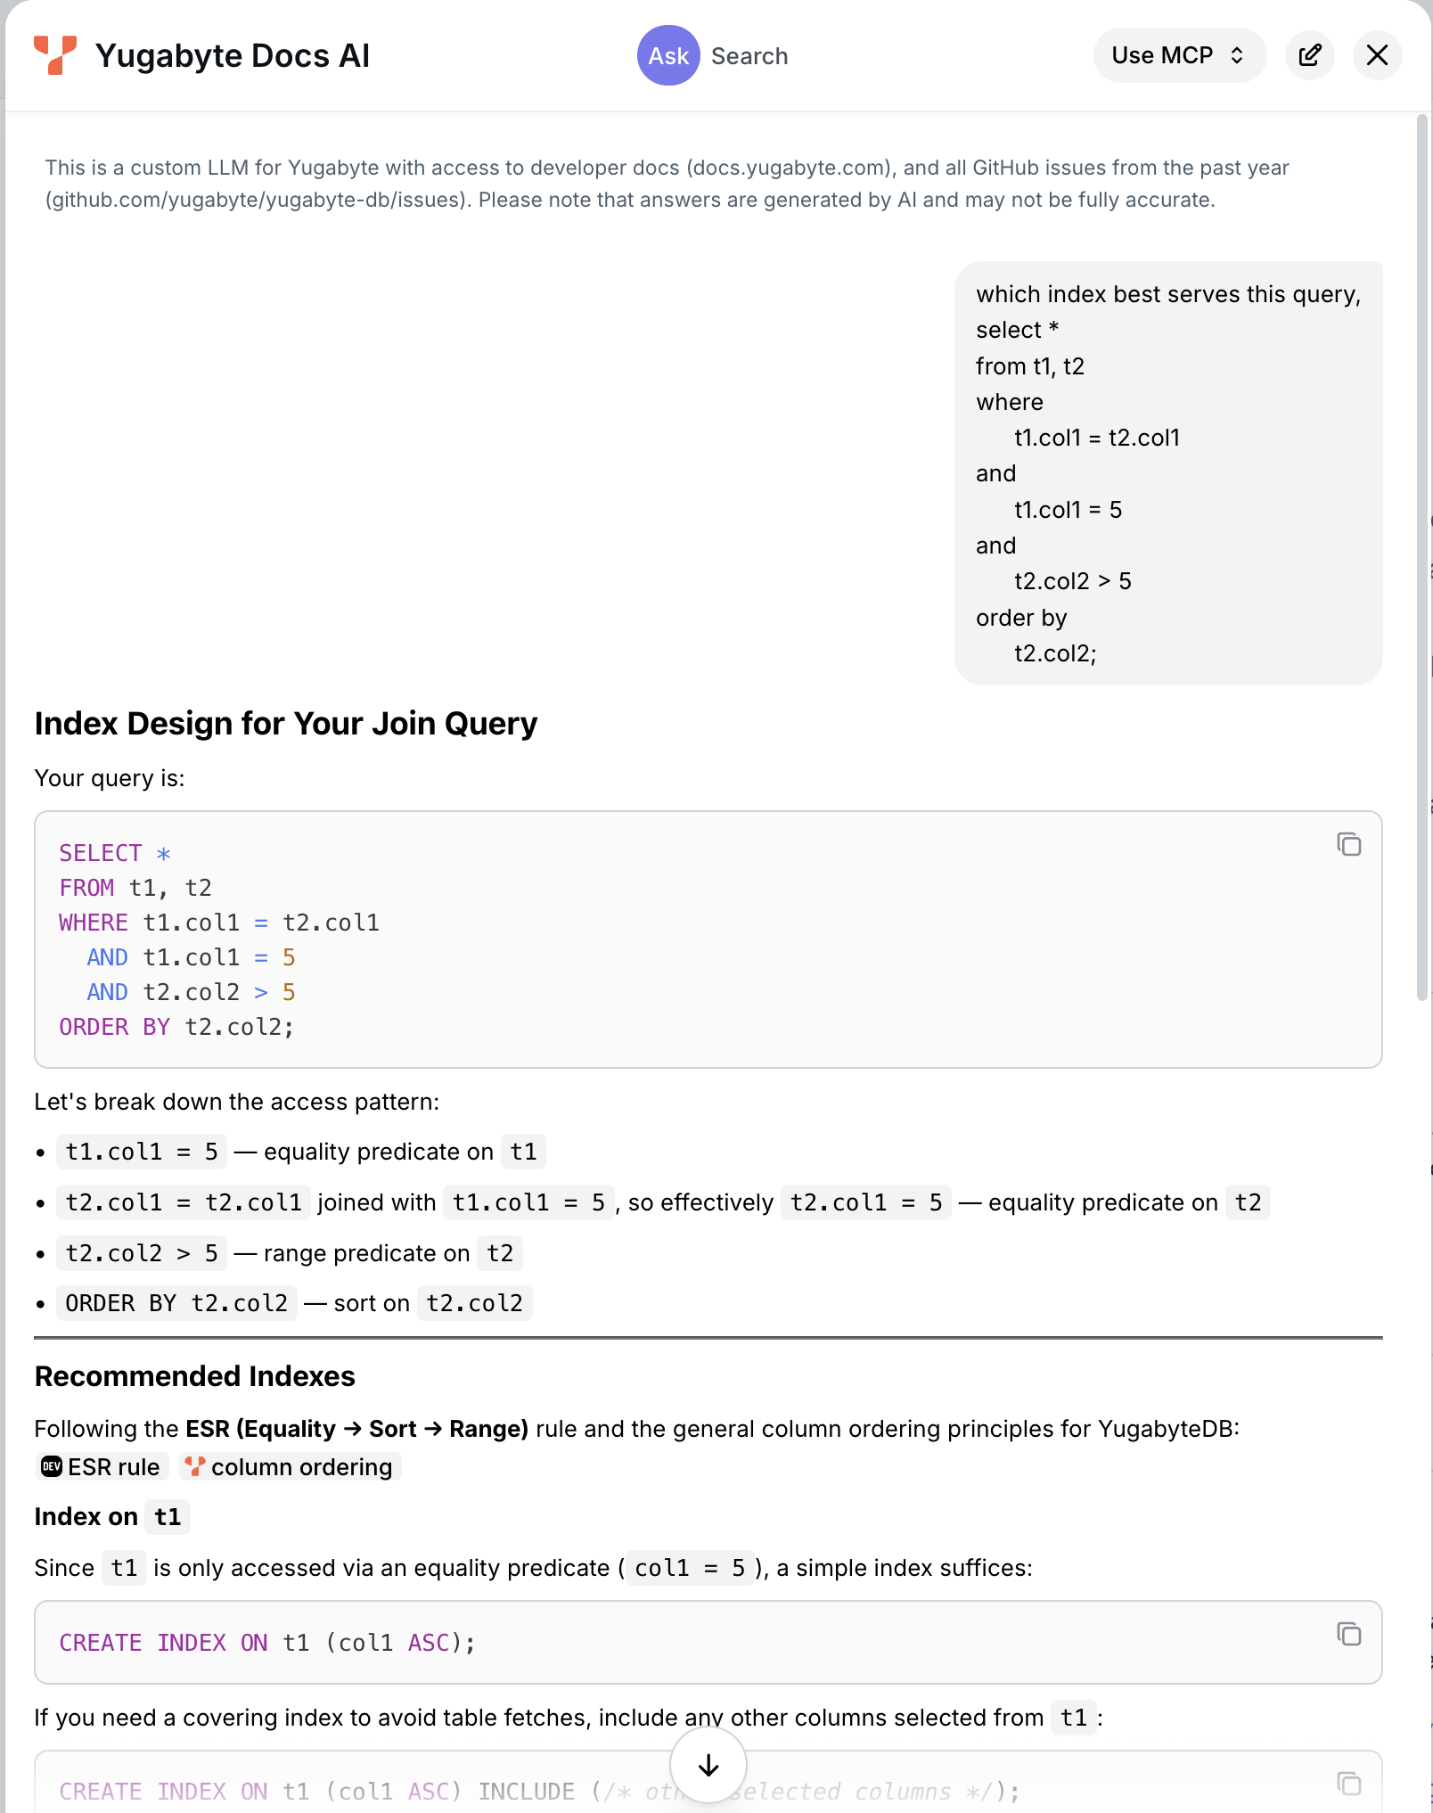
yugabyteDB doc page: Ask AI capability
docs.yugabyte.com

Slide 27
ballpark; where can we make a 5 minute query run in sub-second ? (network tuning, os tuning, ..)
what is index negation ? give an example
besides SELECT, name two query verbs that read
name the 4 stages in the backend that queries go thru
which two does CREATE TABLE experience ? why ?
how can you bypass the parser ? why would you want to ?
what are the 3 primary elements of a query plan and which one pretty much drives the whole process ?
name two file access methods
name two join methods
our two table query, both tables with predicates; what additional two query topics did we introduce here ? briefly describe each
.. WHERE col1 = "FFF" and col2 > 20; knowing nothing else, which predicate returns more rows ? which predicate do we prefer to process first ?
what is a sort pipelining ?
checkpoint
© 2026 All Rights Reserved

Slide 28
example 01
hands on exercise
© 2026 All Rights Reserved

Slide 29
example 02
1
2
3
4
5
6
7
8
9
10
difficulty
one new index negation, one new query rewrite
© 2026 All Rights Reserved

Slide 30
example 02:
5 rules applied in order to determine query plan
outer joins
joins
filters
table size
table cardinality
select *
from t1
where
col1 = 10
or
col2 = 20;

Slide 31
the OR-topped query, the physics
tuples could include-
age = 30 and state = "WI"
age = 10 and state = "CO"
neither
both age = 30 and state = "CO"
how you query process can not affect the result set
huh ?
a given tuple can not be returned twice (in error) because of your chosen query processing
select *
from population
where
age = 30
or
state = "CO";

Slide 32
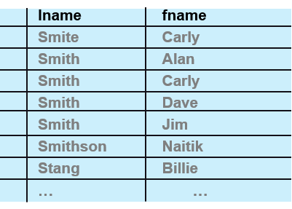
index negation; non-anchored composite key
phone book
sorted (composite indexed) descending by last name, then first name descending
find all persons with first name, Carly
first name is not the first column, not the anchor column
index is now unanchored (data is not sorted by first name)
more performant to be a sequential scan
unless it is key-only (discussed later, but doesn’t help us here)
there is no single index serving (anchored) by both columns

Slide 33
OR-topped query → OR-union transfer (a query rewrite)
select * from t1 where
where col1 = 10
union all
select * from t1
where col2 = 20;
when-
both predicates are indexed
both predicates are selective
use union all when
both predicates produce a unique result set
most performant
use union when
there might be duplicates in the two result sets
(sorts both lists, merge, remove duplicates), blecht
select *
from t1
where
col1 = 10
or
col2 = 20;
select * from t1 where
where col1 = 10
union
select * from t1
where col2 = 20;

Slide 34
example 02
solution
© 2026 All Rights Reserved

Slide 35
example 02: determing the query plan, applying the rules
outer joins
joins
filters
table size
table cardinality
not present
all tables joined (common, 2nd table+)
98% of the time (determines first table)
(not needed)
(not needed)
select *
from t1
where
col1 = 10
or
col2 = 20;
filter → join → sort FJS
only one table; no join methods, no table order, pick a predicate-
because of the chance a row would qualify for both access methods, we need to sort, merge, remove duplicates
without a manual or automatic OR-union transfer, this will only ever be sequential access method

Slide 36
example 02: the actual code behind this
-- Explicit HASH primary key -- see "10 - create exercise 01.sql" for
-- why (col1 is a monotonically increasing sequence; hashing avoids a
-- moving-sequential-hotspot on writes).
CREATE TABLE t1 (
col1 INT,
col2 INT,
col3 TEXT,
PRIMARY KEY (col1 HASH)
);
-- 100,000 rows, col1 = 1..100,000 (unique), col2 = 1..1,000 (repeating)
-- -- ~100 rows match col2 = 20, plus the single col1 = 10 row.
INSERT INTO t1 (col1, col2, col3)
SELECT g, 1 + (g % 1000), repeat('x', 50)
FROM generate_series(1, 100000) AS g;
-- col2 has the same repeating-cycle shape as col1, so HASH here too --
-- same write-hotspot reasoning as everywhere else in this lab.
CREATE INDEX t1_col2_idx ON t1 (col2 HASH);

Slide 37
example 02: running the query
EXPLAIN (ANALYZE)
select *
from t1
where
col1 = 10
or
col2 = 20;

Slide 38
example 02: output from ANALYZE
QUERY PLAN
------------------------------------------------------------------------------------------------------
YB Bitmap Table Scan on t1 (cost=78.55..98.96 rows=101 width=59) (actual time=2.594..2.605 rows=101 loops=1)
-> BitmapOr (cost=54.46..54.46 rows=101 width=0) (actual time=0.954..0.954 rows=101 loops=1)
-> Bitmap Index Scan on t1_pkey (cost=0.00..21.22 rows=1 width=0) (actual time=0.612..0.612 rows=1 loops=1)
Index Cond: (col1 = 10)
-> Bitmap Index Scan on t1_col2_idx (cost=0.00..33.19 rows=100 width=0) (actual time=0.338..0.338 rows=100 loops=1)
Index Cond: (col2 = 20)
Planning Time: 11.312 ms
Execution Time: 3.253 ms
Peak Memory Usage: 190 kB
(9 rows)
because both predicates are supported via indexes, the OR-union transfer functional equivalent is automatically applied (a query rewrite)
other access methods output tuples. bitmap index scan outputs tuple ids (not column values proper). this means we will need to go also to the data page once the result sets are formed. (not a candidate for covering indexes, discussed later.)
bitmap index scan supports efficient; BitMapOr(s), BitMapAnd(s)
BitMapOr, grossly efficient means to intersect two result sets
more notes on next page-

Slide 39
example 02: additional topics
to be aware of-
this is named OR "topped", but it applies to any OR inside a query at any level in the WHERE clause. all ORs cause this branching.
!= and <> can, in given cases, be transformed to an OR
currently, if this doesn't fit in work_mem, this automatic query rewrite will fall back to sequential scan
work_mem
all databases have this; (working) memory or virtual memory (temporary tables)
default 4MB, one allocation per each of sort/hash/aggregate/node/query
SET work_mem = '64MB'; -- session only
SET LOCAL work_mem = '64MB'; -- just this one transaction
ALTER DATABASE my_db SET work_mem = '64MB'; -- per database
ALTER ROLE my_role SET work_mem = '64MB'; -- per user
ysql_pg_conf_csv, work_mem=64MB -- yb-tserver

Slide 40
example 02'ish: a different query, seeing work_mem and sorts
SET work_mem = '16MB';
EXPLAIN (ANALYZE)
select *
from t1
order by
col2;
QUERY PLAN
-----------------------------------------------------------------------------------
Sort (cost=21562.22..21812.22 rows=100000 width=59) (actual time=267.715..279.740 rows=100000 loops=1)
Sort Key: col2
Sort Method: quicksort Memory: 13229kB
-> Seq Scan on t1 (cost=21.09..13257.40 rows=100000 width=59) (actual time=2.579..241.263 rows=100000 loops=1)
Planning Time: 10.982 ms
Execution Time: 293.255 ms
Peak Memory Usage: 19755 kB
(7 rows)

Slide 41
example 02'ish: a different query, seeing work_mem and sorts
SET work_mem = '4MB';
EXPLAIN (ANALYZE)
select *
from t1
order by
col2;
QUERY PLAN
-----------------------------------------------------------------------------------
Sort (cost=25324.72..25574.72 rows=100000 width=59) (actual time=266.545..271.658 rows=100000 loops=1)
Sort Key: col2
Sort Method: external merge Disk: 6768kB
-> Seq Scan on t1 (cost=21.09..13257.40 rows=100000 width=59) (actual time=2.290..234.344 rows=100000 loops=1)
Planning Time: 10.003 ms
Execution Time: 285.005 ms // what ??
Peak Memory Usage: 5238 kB
(7 rows)

Slide 42
example 02'ish: a different query, sort time jitter on small sized data
The Sort node’s own actual time=X..Y numbers mix two different things: X (time to first row) already includes the child Seq Scan’s full time plus the sort itself, since Sort is a blocking operator.
So Execution Time differences between runs were mostly driven by the Seq Scan underneath — which is identical logic either way and, on this shared cluster, varied noisily between 237ms and 289ms across otherwise-identical runs, dwarfing whatever the sort itself costs.
Subtracting the scan’s own time from the sort’s start time isolates the actual sort cost:
run in-memory quicksort external merge (disk)
1 29.7ms 32.5ms
2 25.9ms 34.0ms
3 26.7ms 36.4ms
avg ~27.4ms ~34.3ms
Once the scan noise is stripped out, the disk-spilling sort is consistently slower, as expected — quicksort has no I/O to pay for.
The one-off result in the slides where the disk version looked faster was Execution Time being dominated by scan-time jitter on the shared cluster, not anything about the sort method itself.
Total Execution Time isn’t a reliable way to compare these two — the scan noise (tens of ms) is larger than the real sort-method difference (~7ms).

Slide 43
example 02: optional exercise
as an optional exercise only
disable bitmap scans
SET enable_bitmapscan = off; -- or
SET yb_enable_bitmapscan = off;
run the OR-topped query as is
do your own OR-union transfer

Slide 44
checkpoint
which index negation was introduced in this example
which query rewrite was introduced in this example
what is the difference between UNION and UNION ALL
where does work_mem go if it overflows
the default work_mem is 4MB; on node node, how much memory might you use for this query-
select
col2,
count(*) as row_count
from t1
group by col2
order by row_count desc;
© 2026 All Rights Reserved

Slide 45
example 02
hands on exercise
© 2026 All Rights Reserved

Slide 46
example 03
1
2
3
4
5
6
7
8
9
10
difficulty
another index negation, a new index type
© 2026 All Rights Reserved

Slide 47
aaa
aaa

Slide 48
aaa
aaa

Slide 49
aaa
aaa

Slide 50
aaa
aaa

Slide 51
demonstration:
web program

Slide 52
Next step ..
___
___
___
___

Slide 53

end
Notes:
Yugabyte was founded on the belief that the next decade will see a major change in the systems of record that enterprises use to run their businesses and offer digital services. We are the company behind YugabyteDB, a distributed SQL database built first and foremost for transactional applications and to support enterprises as they move into a cloud-native, digital-led world. The database is 100% open source and designed to run on any cloud: private, public, hybrid, multi-cloud — flexibility and openness are essential to our customers and position us uniquely in the distributed SQL market. YugabyteDB is used by both small companies and by the Fortune 500 alike - by retailers, advertisers, financial services companies, telecom and others.

Slide 54
query optimizer; what constitutes a query (execution) plan
predicate pushdown, filter placement
deciding where in the plan tree to apply a WHERE-clause filter, ideally as early as possible to reduce tuple counts before expensive operations
aggregation strategy
hash aggregate vs. sort-then-group-aggregate for GROUP BY
sort elimination
recognizing when an index already delivers tuples in the order an ORDER BY or GROUP BY needs, avoiding an explicit sort step entirely
subquery transformation
rewriting a correlated subquery into a join (or vice versa), converting IN/EXISTS into semi-joins/anti-joins, or "unnesting" subqueries into the main query when it's provably equivalent and cheaper
materialization versus pipelining
rewriting a correlated subquery into a join (or vice versa), converting IN/EXISTS into semi-joins/anti-joins, or "unnesting" subqueries into the main query when it's provably equivalent and cheaper
…

Slide 55
query optimizer; what constitutes a query (execution) plan
…
parallel execution planning
how many worker processes to use for a parallel scan/join/aggregate, and whether parallelism is even worth the coordination overhead for this particular query
partition pruning
or partitioned tables, determining which partitions can be skipped entirely based on the query's filter conditions
constants folding, expression simplification
or partitioned tables, determining which partitions can be skipped entirely based on the query's filter conditions
view/CTE inlining
whether to expand a view or CTE inline into the surrounding query (allowing cross-boundary optimization) or treat it as an optimization fence (materializing it separately)

Slide 56
Clip art

Slide 57
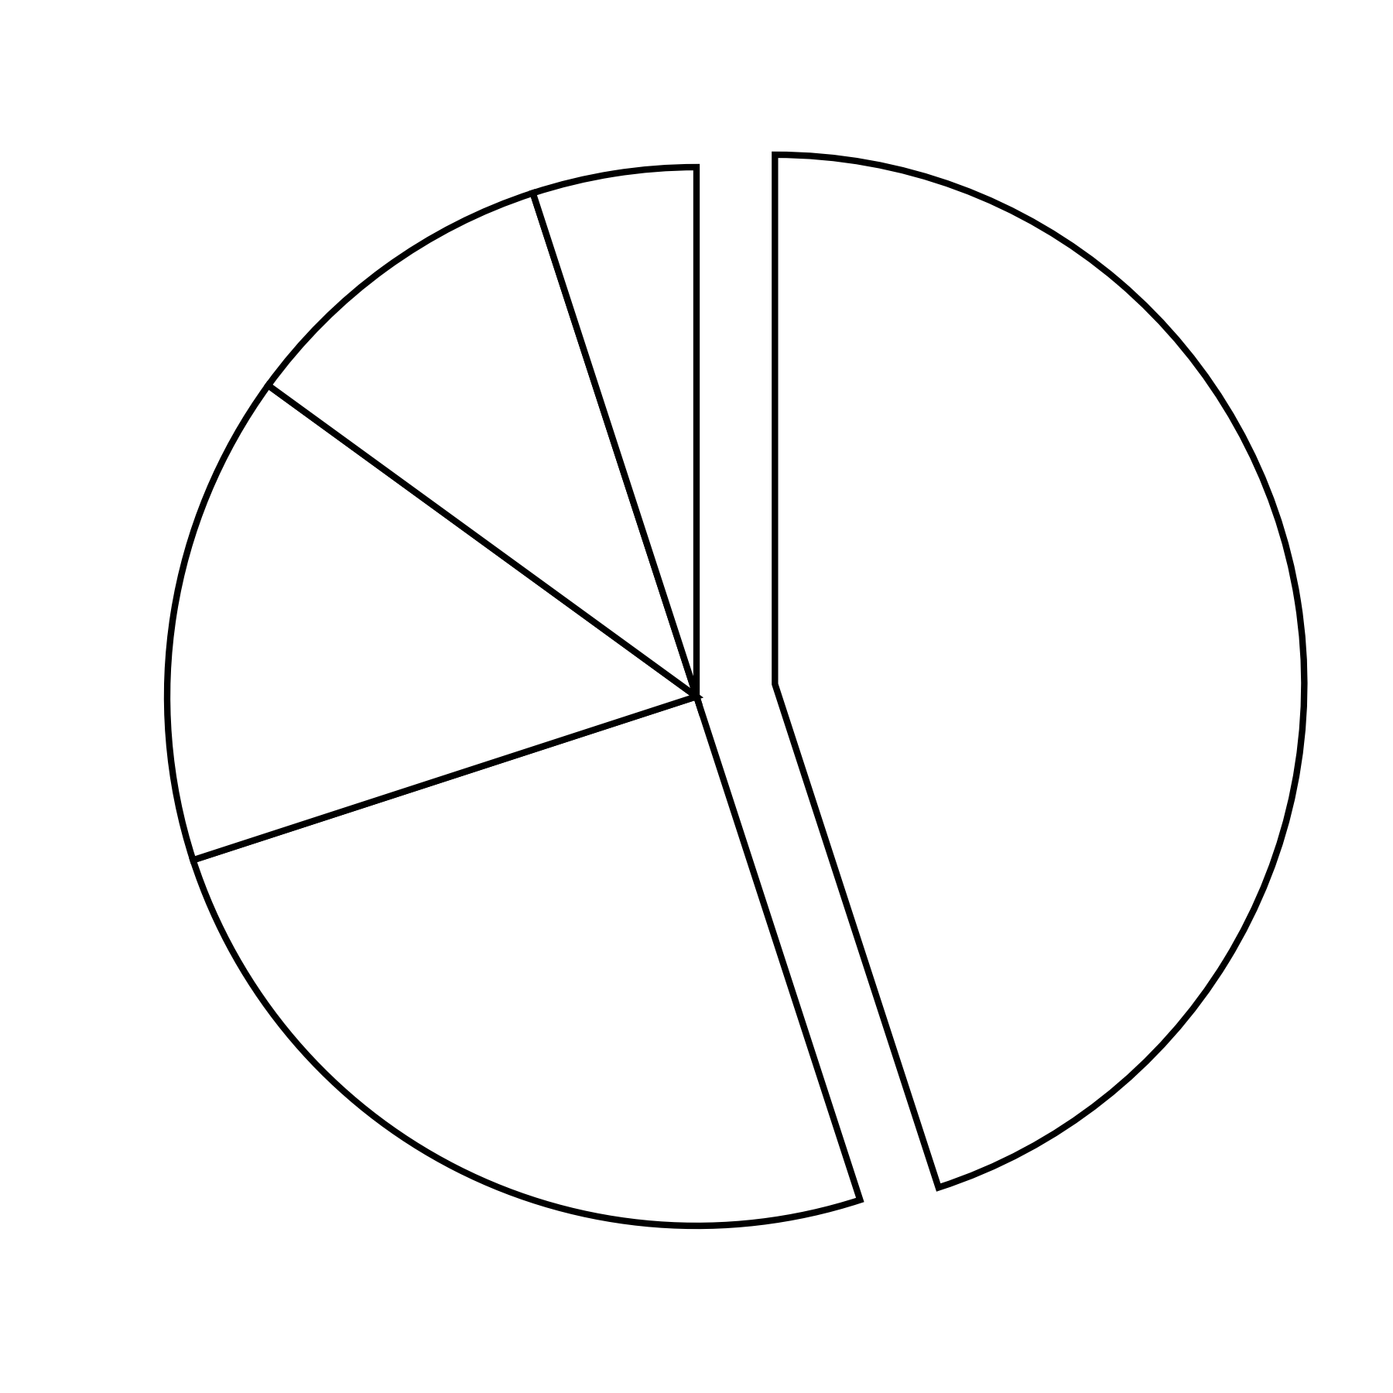

Slide 58
cust_num
col_x
order_num
order_num
order_date
101
aaa
401
401
09/01/16
102
bbb
402
402
11/12/15
103
ccc
403
403
07/07/18
104
ddd
404
404
07/07/18
105
eee
405
405
04/04/15
106
fff
406
406
03/12/12
107
ggg
407
407
08/02/18
…
…
…
…
…

Slide 59
lname
fname
Smite
Carly
Smith
Alan
Smith
Carly
Smith
Dave
Smith
Jim
Smithson
Naitik
Stang
Billie
…
…

